Slide 1

BLINKIT SALES DATA ANALYISIS
An in-depth look at the Blinkit project Objectives , business needs , and Power BI skills development

Slide 2
AGENDA
1
Introduction
5
Types of Visual Uses
2
Project Overview
6
Key Insights
3
Business Requirements
7
Recommendations
4
Data Analysis Steps
8
Conclusion

Slide 3

Introduction to Blinkit Grocery Data Analysis
This Section will provide an overview of the objectives of the presentation , including the significance of grocery data analysis in enhancing business strategies and customer engagement

Slide 4
Project Overview
Highlighting Successful Completion and Skills Developed
Introduction to the Project
The Blinkit Grocery Data Analysis project serves as a comprehensive initiative focused on analyzing grocery data to derive actionable insights. This project highlights the importance of data in decision-making processes within the grocery industry.
Successful Completion
The project was successful completed, showcasing my ability to analyze complex datasets and deliver valuable insights. This accomplishment emphasizes the effective collaboration and dedication of the team members involved.
Utilizing POWER BI
Power BI was the primary tool used for visualizing the data. Its capabilities allowed me to create interactive dashboards that facilitated better understanding of the data patterns and trends.
Impact on Decision Making
The insights gained from the data analysis have the potential to significantly impact the grocery sector. Stakeholders can leverage these insights for the strategic planning and operational improvements.

Slide 5

Business Requirements
Analyzing Sales Performance and Customer Insights
STRONG TOTAL SALES PERFORMANCE
1.20M
With total sales reaching
1.2M, Blinkit has demonstrated a solid market presence. This figure indicated a healthy revenue stream and suggests that marketing strategies and product offering are resonation well with customer.
HEALTHY AVERAGE SALES PER TRANSACTION
141
An average sales figure of
141 per transaction reflects effective pricing strategies and product bundling. It suggests that customer find value in their purchases, indicating potential for upselling opportunities.
ROBUST VOLUME OF ITEMS SOLD
8523
Selling 8,523 items highlights the high demand for Blinkit’s products. This volume suggests a strong customer base and effective distribution strategies, indicating room for expanding product lines.
ABOVE-AVERAGE CUSTOMER SATISFACTION
3.9
An average customer rating 3.9 indicates a generally positive customer experience. While this is a good score, there is room for improvement in customer service or product quality to achieve even higher satisfaction

Slide 6
DATA ANALYSIS STEPS
Requirement Gathering
Data Walkthrough
Data Collection
Data Cleaning/Quality Check
Data Modelling
Data Processing
Dashboard Layout Design
Charts Development and Formatting
Dashboard/Report Development
Insights Generation

Slide 7
Types of Visuals Used
Effective Visual Tools for Business Analysis
KPI Visualization
Utilize cards to effectively display Key Performance Indicators (KPIs), allowing for quick insights into business performance and success metrics.
Performance Metrics
Implement metrics for tracking performance, helping to gauge success and identify areas for improvement in operational processes.
Fat Content Analysis
Use a donut chart to visually represent fat content in various products, making it easier to analyze nutritional information at a glance.
Geographic Distribution
Leverage a funnel chart to depict geographic distribution of sales, enabling businesses to visualize how sales funnel through different regions.
Sales by Item Type
Employ a clustered bar chart to illustrate sales by item type, allowing for comparative analysis and insights into product performance.
Sales Trends Over Time
Utilize a line chart to track sales trends over time, providing a clear view of performance fluctuations and growth trajectories.
Comprehensive Metrics Analysis
Implement a matrix to present comprehensive metrics by outlet type, facilitating detailed analysis and strategic planning.

Slide 8
Key Insights
Understanding Key Market Dynamics
Fat Content Preference
Low fat products dominate sales, accounting for 64.6% of total sales compared to 35.4% for regular fat products. This indicates a clear consumer preference for healthier options.
Outlet Size Performance
Medium-sized outlets perform the best, capturing 42.27% of sales. This suggests they are effectively meeting local consumer needs compared to smaller and larger outlets.
1
4
Item Type Performance
Fruits and vegetables lead in sales with a total of $178,125. This suggests a strong market for these categories and potential growth opportunities for seafood products.
Geographic Insights
Sales in Tier 3 cities have outperformed other tiers, achieving $472,133. This highlights the importance of targeting these emerging markets for growth.
2
5
Sales Trends
Sales peaked in 2018 at $205,000, followed by a noticeable decline. Investigating the factors behind this decline could reveal critical insights for future strategies.
Outlet Type Effectiveness
Supermarket Type 1 shows the highest sales at $787,551, indicating that this outlet type is particularly effective in attracting and retaining customers.
.
3
6

Slide 9
Recommendations
Strategic Actions for Market Growth
Boost Seafood Marketing
Develop strategies to enhance seafood sales through targeted campaigns. Emphasizing the nutritional benefits and sustainability of seafood can attract health-conscious consumers.
Expand Low Fat Product Lines
Focus on promoting low fat options based on consumer preference. Recent trends indicate a growing demand for healthier alternatives, making this a critical area for growth.
Analyze Post-2018 Decline
Investigate market conditions contributing to the decline in sales since 2018. A thorough analysis will help identify areas for improvement and inform future strategies.
Leverage Medium-Sized Outlets
Enhance strategies for medium-sized outlets while improving large outlet performance. Medium-sized outlets often cater to localized markets and can be pivotal in driving sales.
Target Marketing to Tier 3 Cities
Develop tailored marketing strategies to capitalize on strong sales in these areas. Understanding the unique preferences and purchasing habits of Tier 3 city consumers is essential.
Expand Supermarket Offerings
Explore opportunities to replicate the success of Supermarket Type 1 across other outlet types. Identifying successful product lines and strategies can enhance overall sales.

Slide 10
BLINKIT GROCERY SALES DASHBOARD

Slide 11
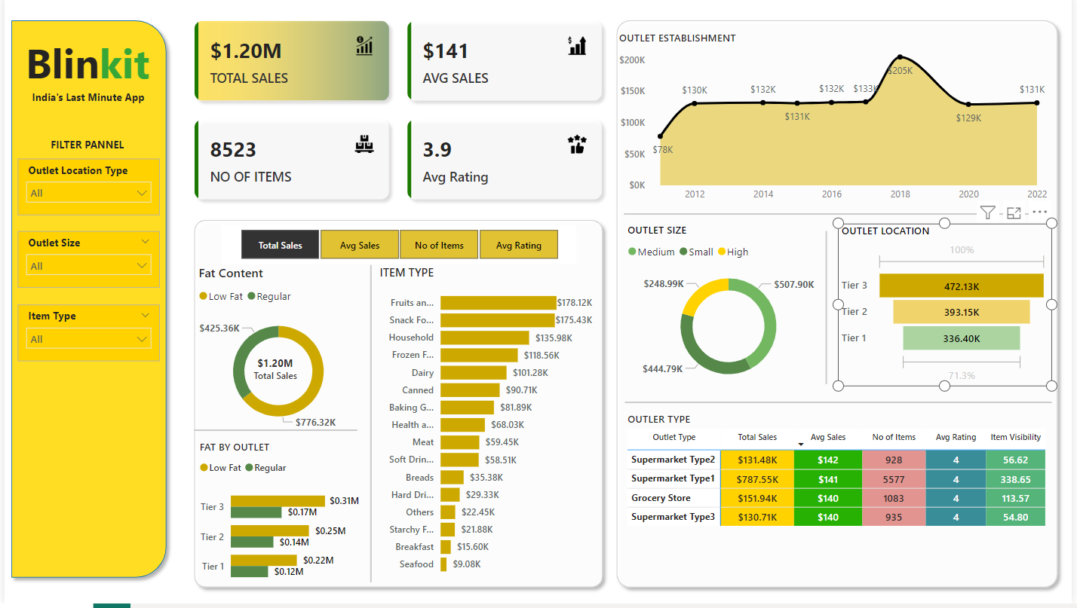

Slide 12



Enthusiasm for Future Projects
I am excited to apply the skills acquired in data analytics to future projects. This enthusiasm stems from a recognition of the transformative power of data in shaping business strategies and outcomes. Embracing these skills will allow for more informed decisions and innovative approaches in tackling complex business challenges.
CONCLUSION
Harnessing the Power of Data for Business Success
The Importance of Data-Driven Decision Making
Data-driven decision-making is crucial for aligning insights with business goals. This approach not only enhances operational efficiency but also drives strategic initiatives by utilizing verifiable data to guide decisions. Organizations that leverage data effectively are more likely to achieve their objectives and stay competitive in the marketplace.

Slide 13

Thank you
Kshitij D Taware
kshitijtaware06@gmail.com

